Slide 1
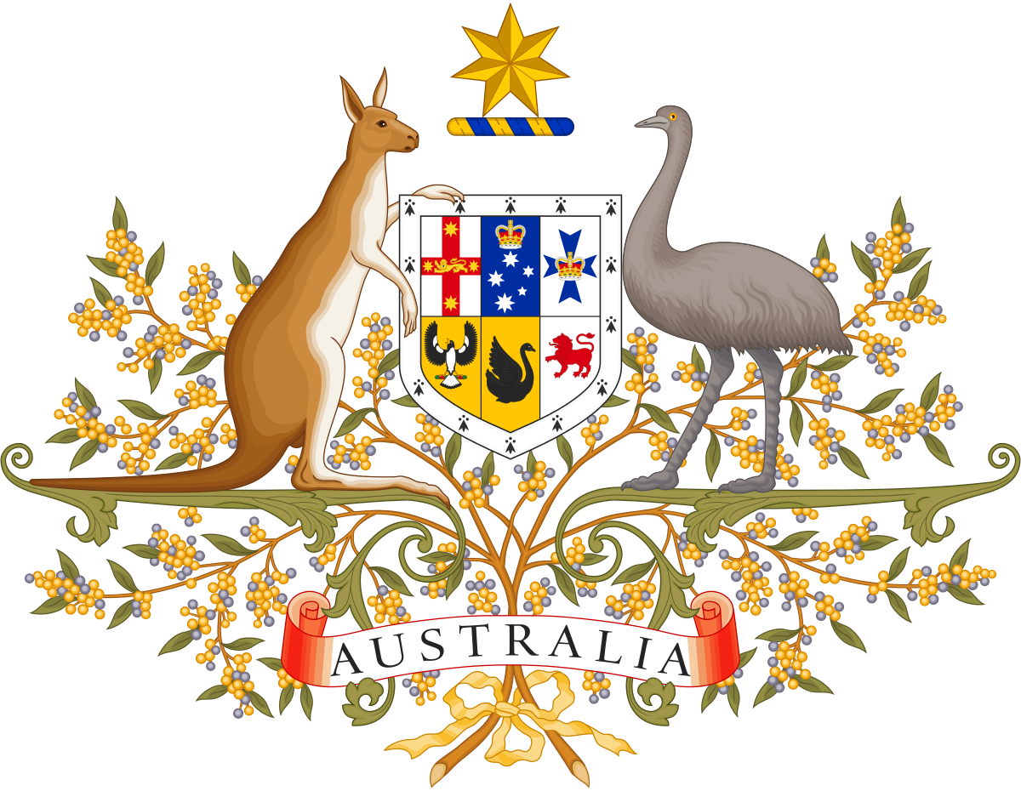
Australia’s System of Government

Slide 2
This term we will look at…
Australia’s System of Government: Federation, Constitutional Monarchy & Representative Democracy
The 3 Levels of Government and their Responsibilities: Federal, State & Local
Electing Members of Parliament: Houses of Parliament
Holding an Election
How Government is Formed
Making Laws: In-school Activity
Writing, Debating & Voting on Bills
Referendums & Plebiscites
Fighting for Rights to Vote: Women and Aboriginal People

Slide 3
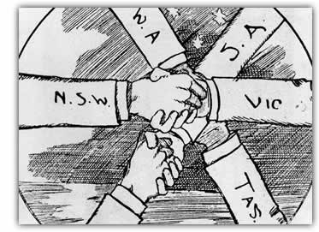
Federation

Slide 4
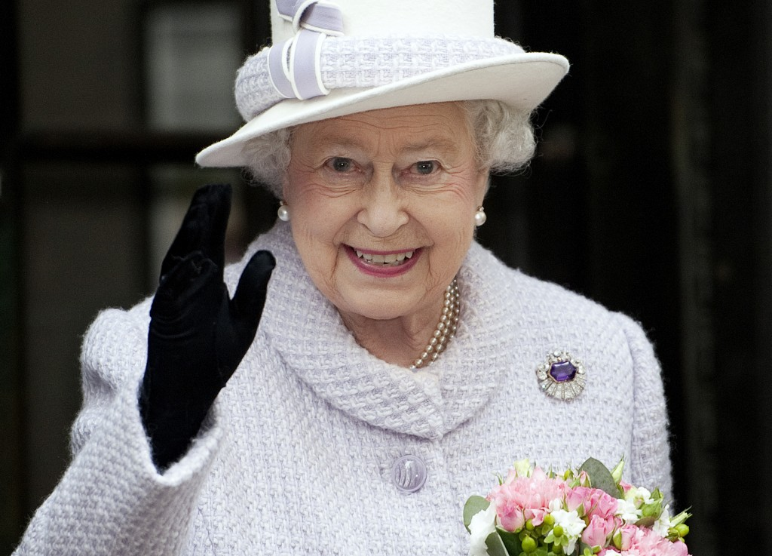
Constitutional Monarchy

Slide 5
Representative Democracy

